Slide 1
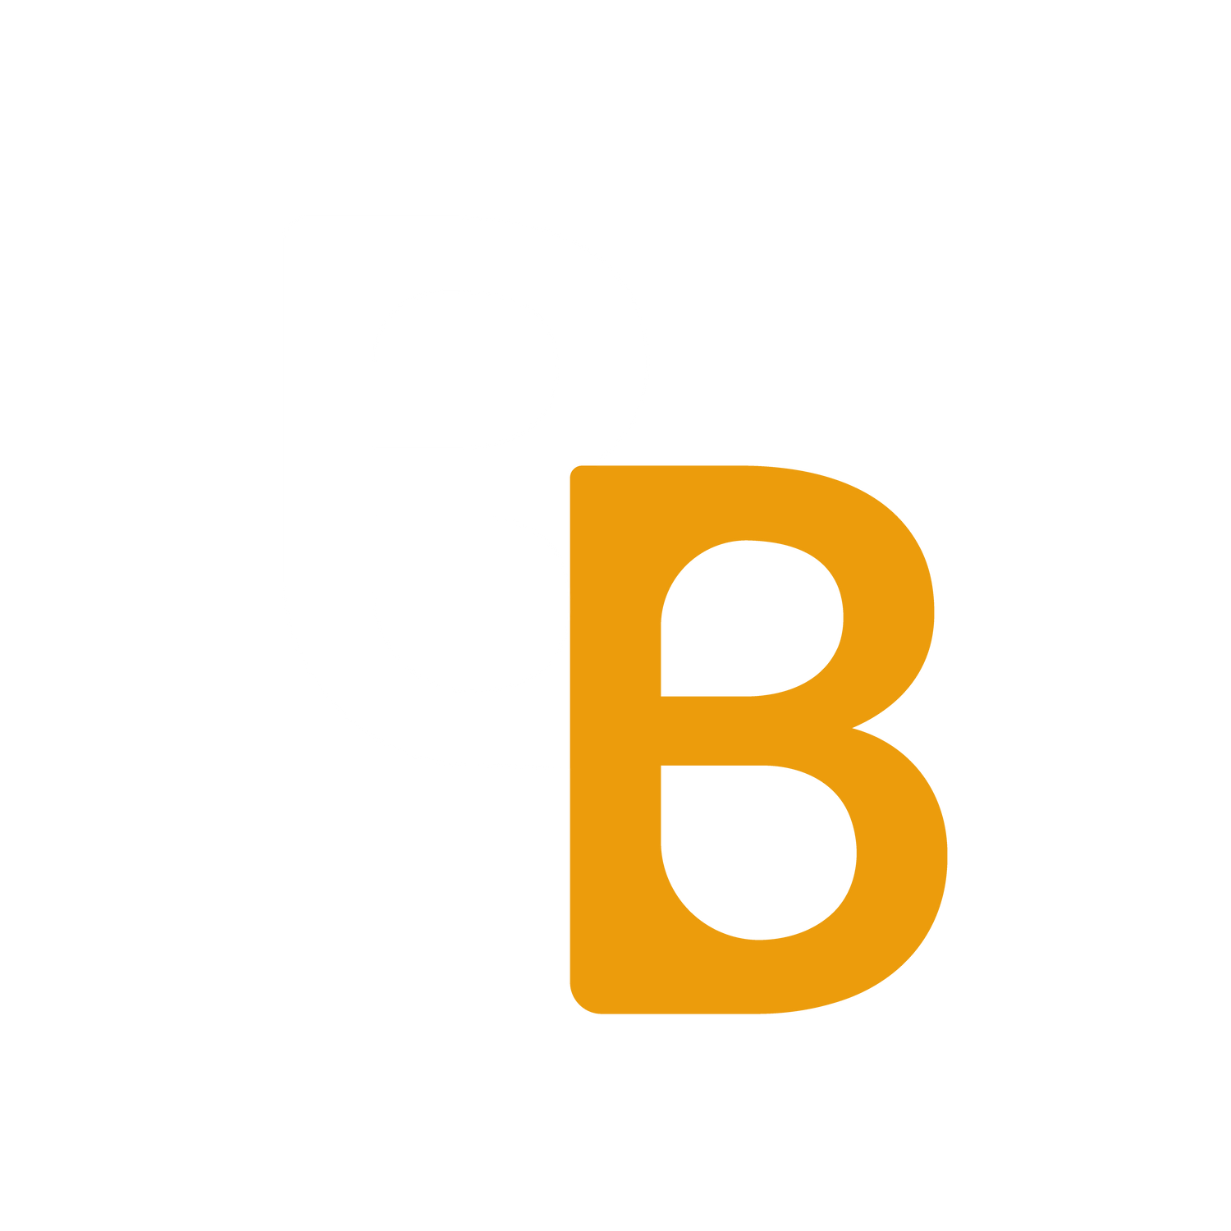
Project 02
CREATED BY:
Hector Domínguez
Isabella Ruiz
Jesús Mondragón
Jonathan Cobos
Nelly Fabela
Raymundo Ponce
BetBud

Slide 2
Application Concept
BetBud
BetBud is an app where the goal is to make bets with your friends in a lighthearted, fun way.
When using the application you can invite any friend you like and make any type of bet that includes the following categories:
Food - Drinks - Giftcards - Movie Theater
There are several things you can bet starting with meals, nachos or combo deals, giftcards and even beer!
BetBud

Slide 3

Motivation
BetBud
Do you like the thrill of taking risks? And how about them actually not being too risky?
Are you tired of the same old social media apps and games that you've been using for the last five years? So are we.
The motivation for creating BetBud was mainly to have in the palm of our hands a new way to interact with our social circle, while being able to win prizes for it. Prizes that don't necessarily mean money but something enjoyable and usable.

Slide 4

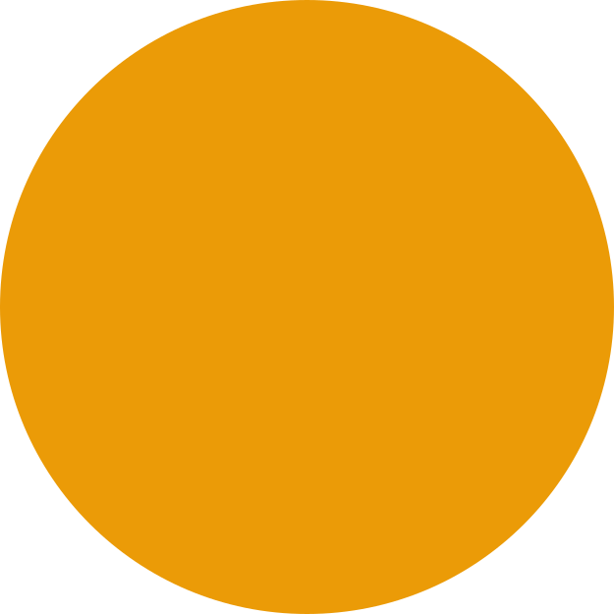

BetBud's design process
BetBud
1
2
3
4
Discussed as a team the app's operation, features and needs
Defined the data needed for the app to function
Map out the pages and overall layout for the features
Distribute the work according to the team member's strengths
5
6
7
Work on the backend to meet the needs of the app
Work on the frontend making sure it works with the backend in parallel
Connected the frontend with the backend to start testing the project and make it work

Slide 5



Technologies used
BetBud
POST route
Cookies
Requests to a specified path with a specified callback function
Data stored on the web browser by websites visited
Sequelize ORM
MySQL
Node.js
Creates front and back-end applications with JS
Allows to manage SQL databases easily
Open source database for browsers

Slide 6


Technologies used
BetBud
GET route
MVC paradigm
API keys
Requests a certain URL path or pattern
Brings information from other websites
A pattern specifying the model, view and controller in an application
Express.js
Handlebars.js
Web framework that works for node.js
Template used with JS

Slide 7
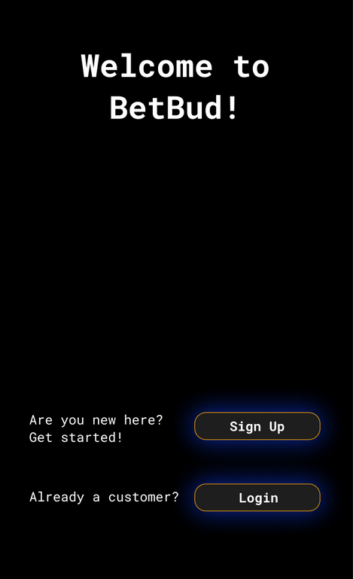
Demonstration
BetBud

Slide 8

Directions for future development
BetBud
Learning overall UX/UI improvement for the appp
Debugging the common issues appearing when testing the app
Listing all the items that can be bet
Making sure that the items bet are redeemable in the user's area
Include a map for knowing the sorroundings available for betting a bud

Slide 9
BetBud
THANK YOU!

